Slide 1

Tools and Applications for Numerical Computation
Exam project
Author
Alessandro Sebastianelli
PhD Candidate at University of Sannio
E-mail: sebastianelli@unisannio.it
Code available on my Git-Hub page
https://github.com/Sebbyraft/SentinelDataAnalysis

Slide 2
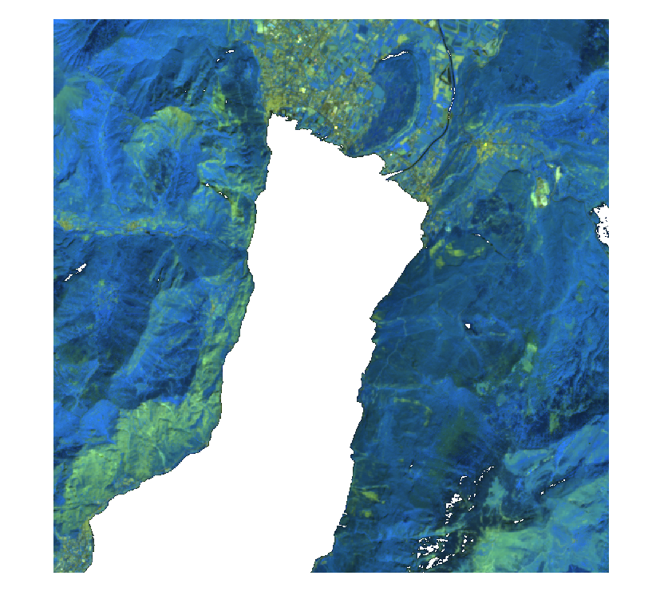
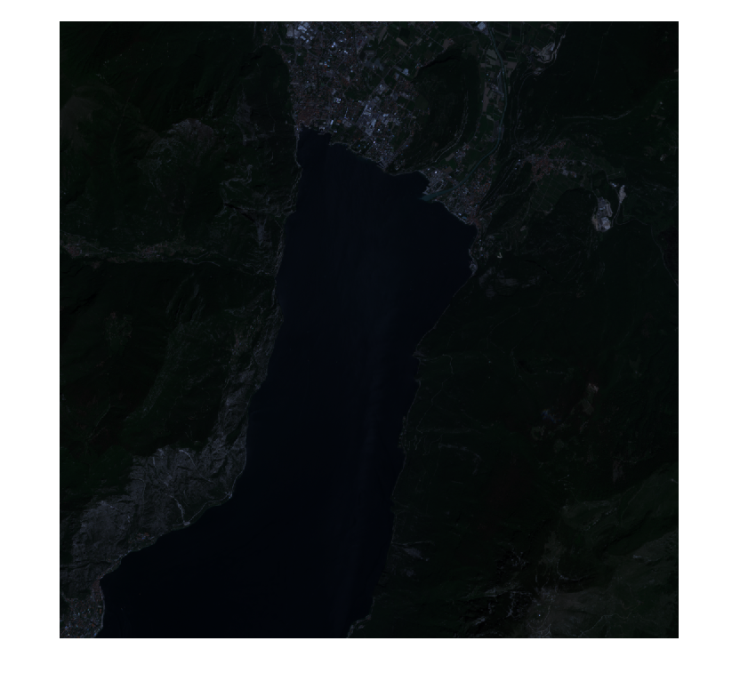
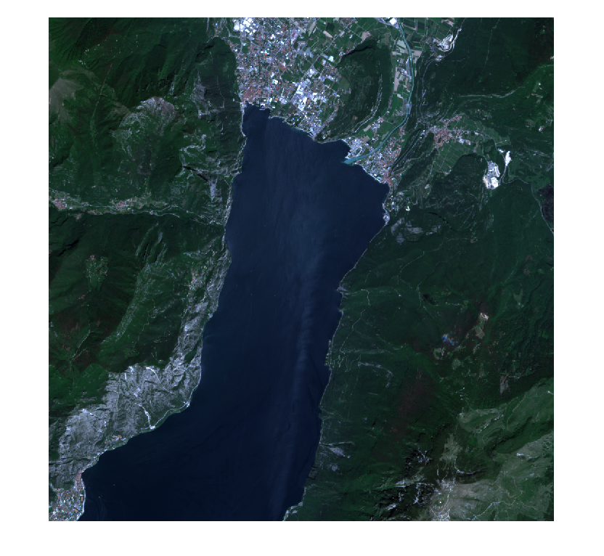
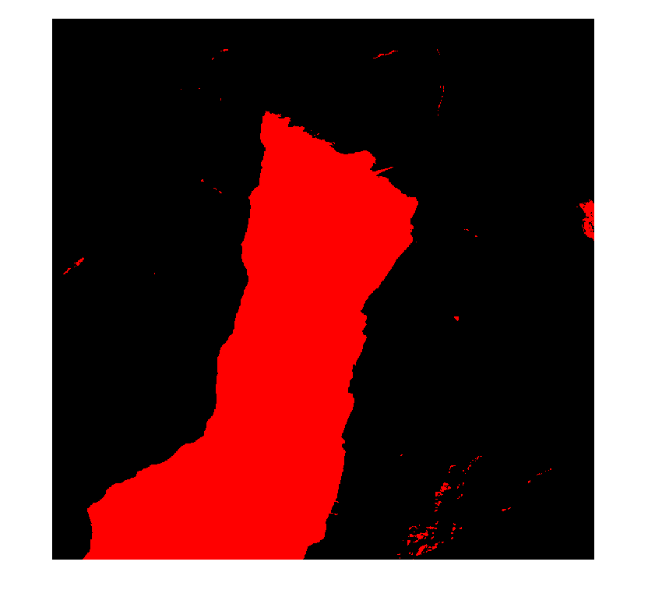
The idea
The idea is to implement a library of functions for pre and post processing of satellite data.
Postprocessing
Preprocessing
Postprocessing

Slide 3
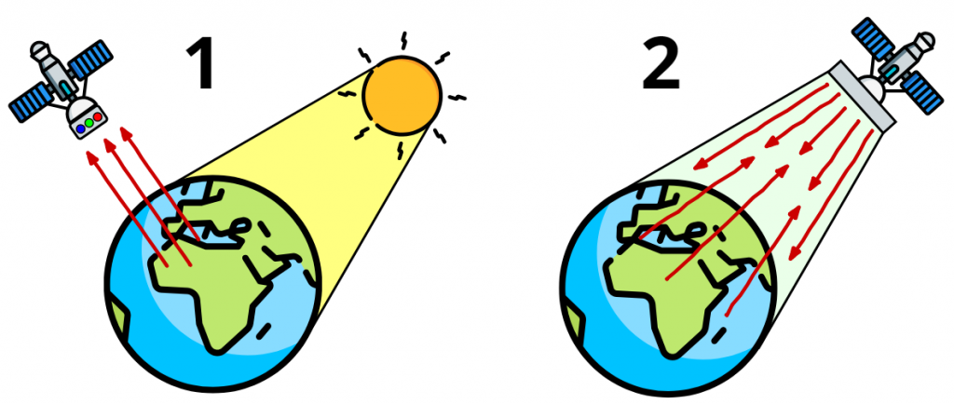
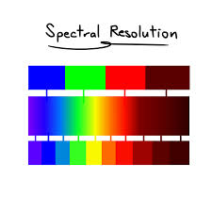
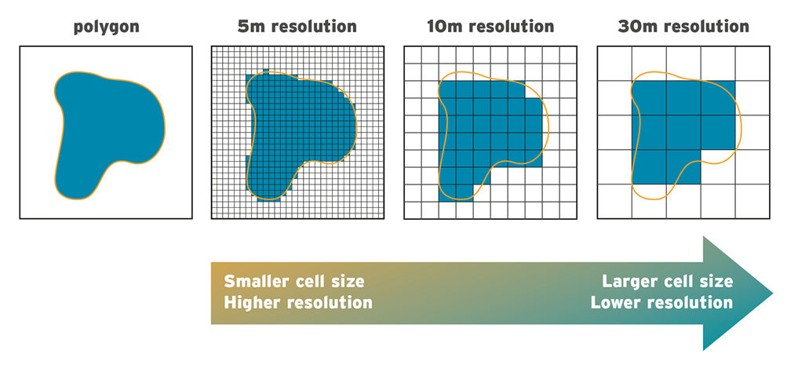
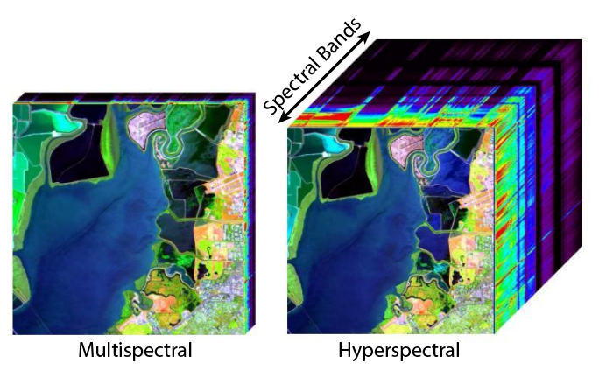
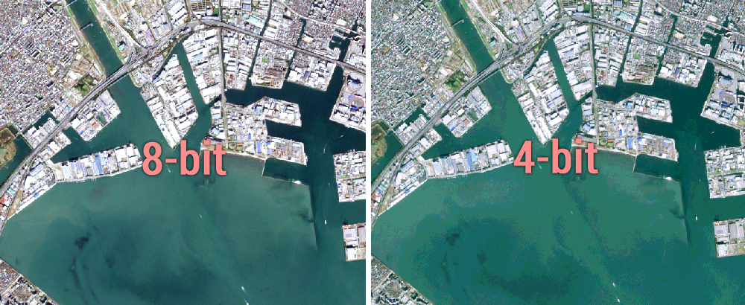
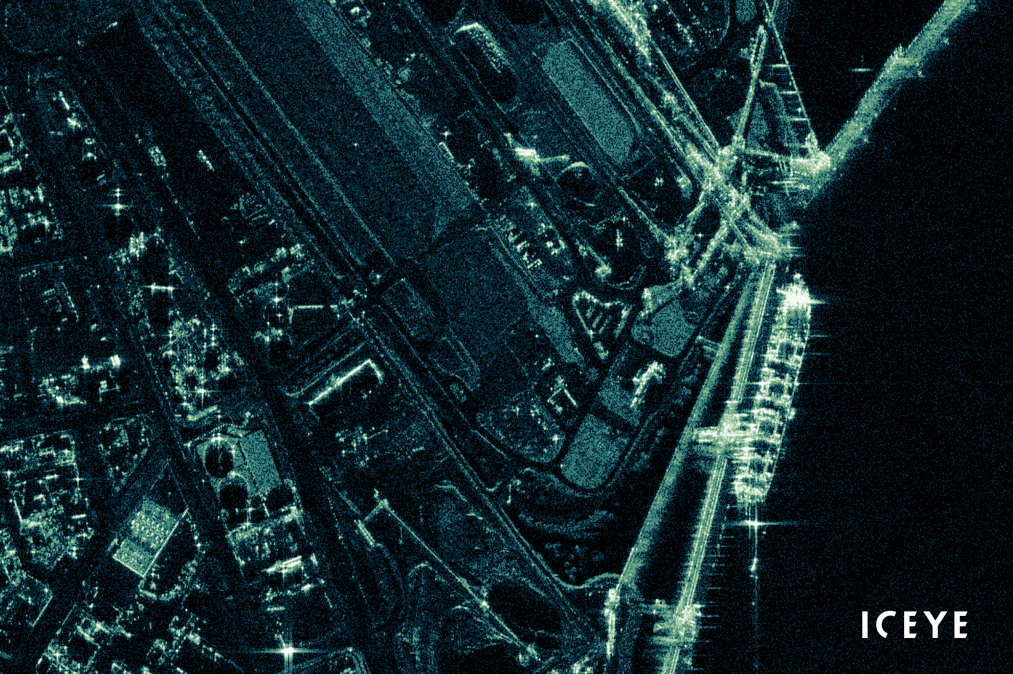
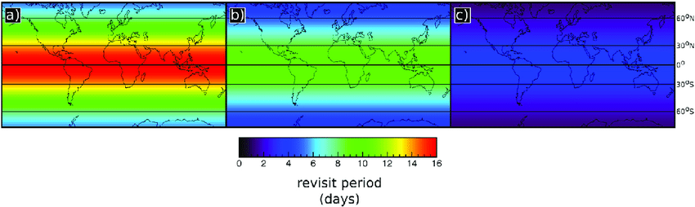
Short intro to Satellite data
Passive
Active

Slide 4
Pre-processing functions

Slide 5
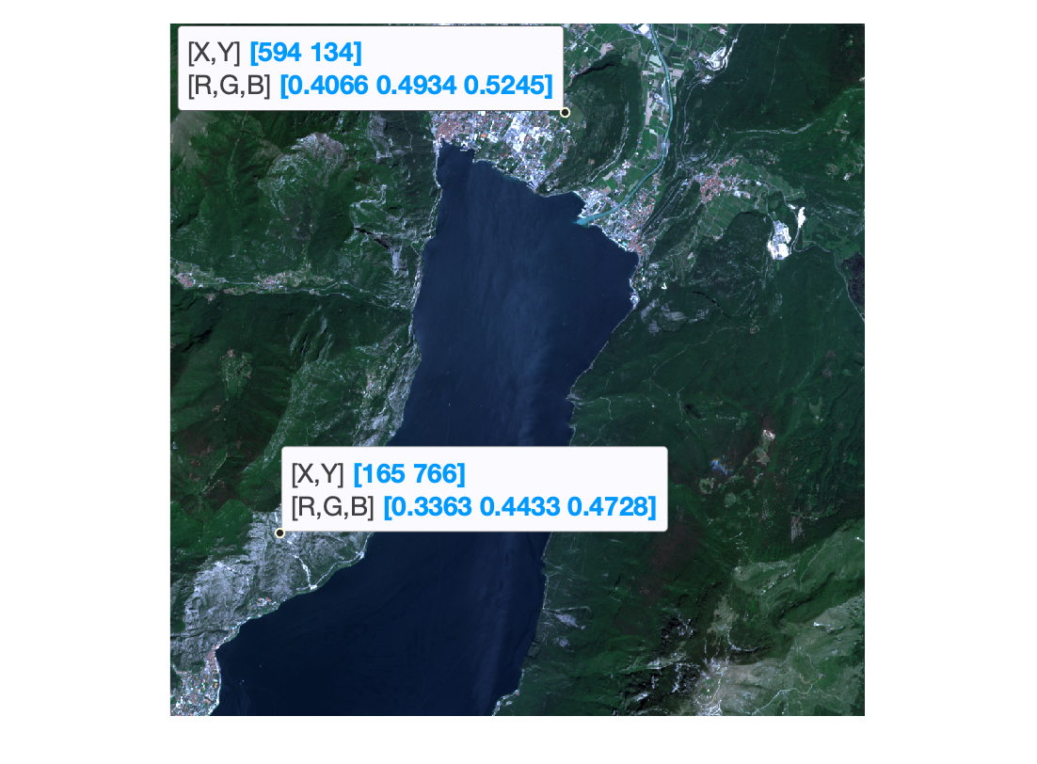
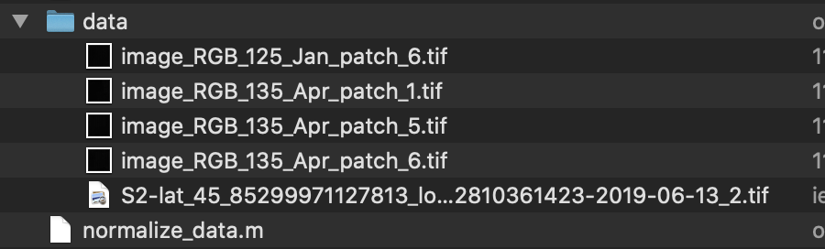
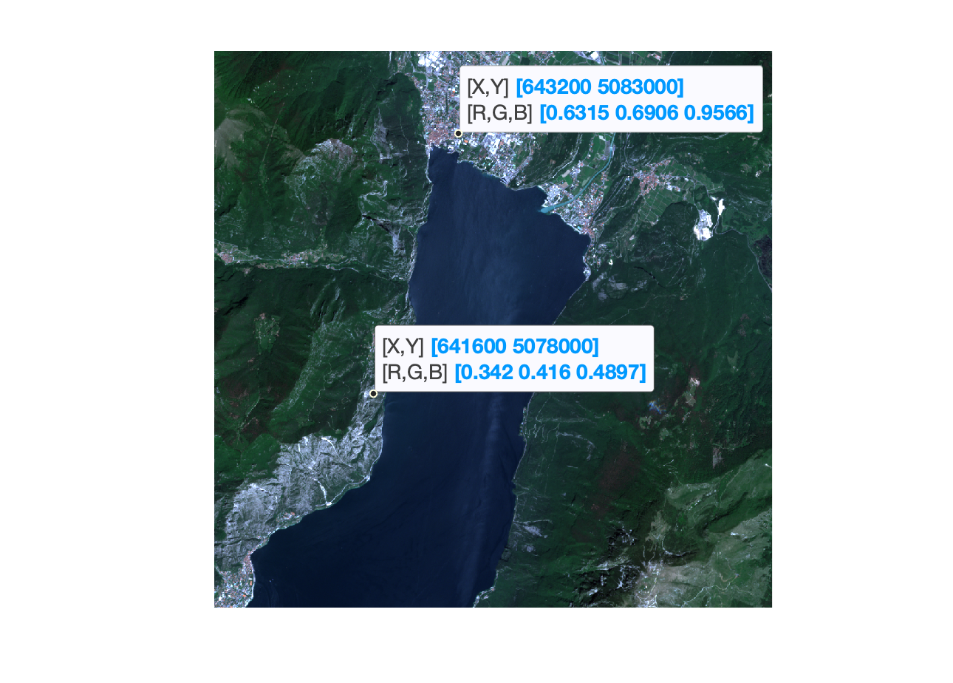
Read data
This function is used to import the data given the path and a loading modality.
Click me
”std” mode -> without metadata
The geo loading mode, allow to read both the data values and the metadata values:
Resolution
Geographical coordinates
Raster size
…
”geo” mode -> with metadata

Slide 6
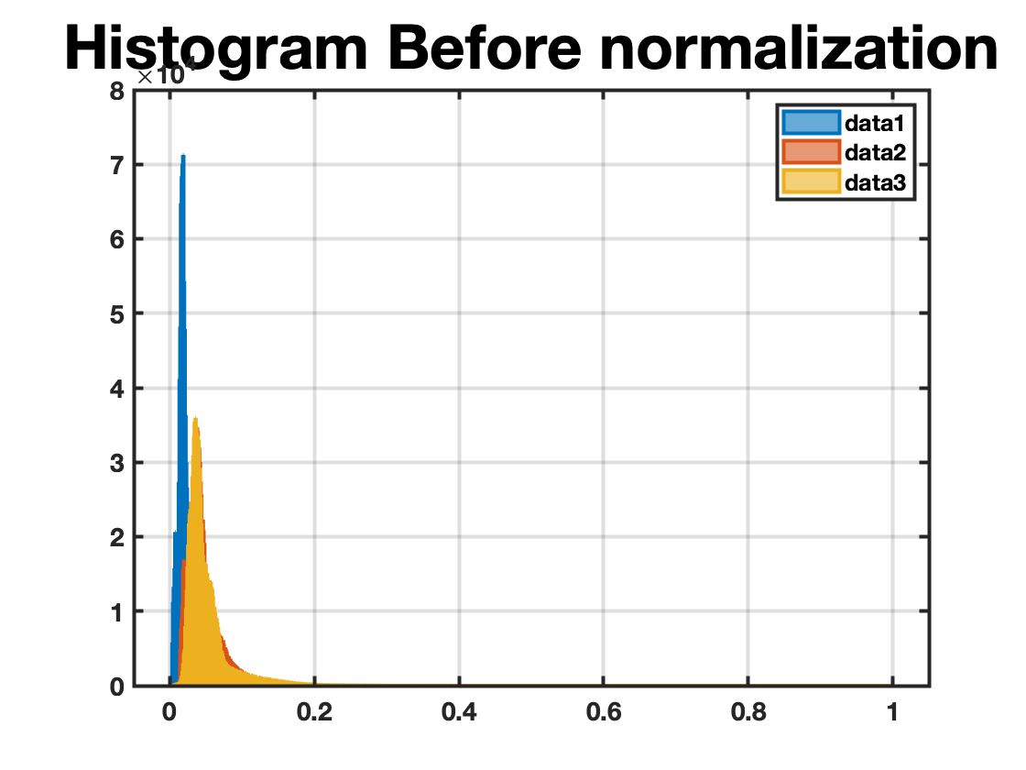
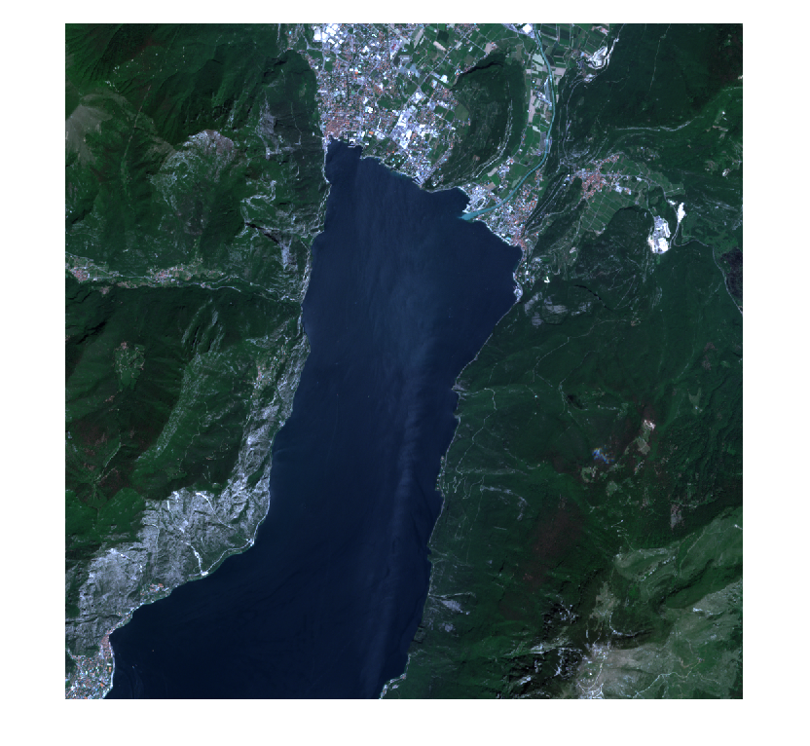
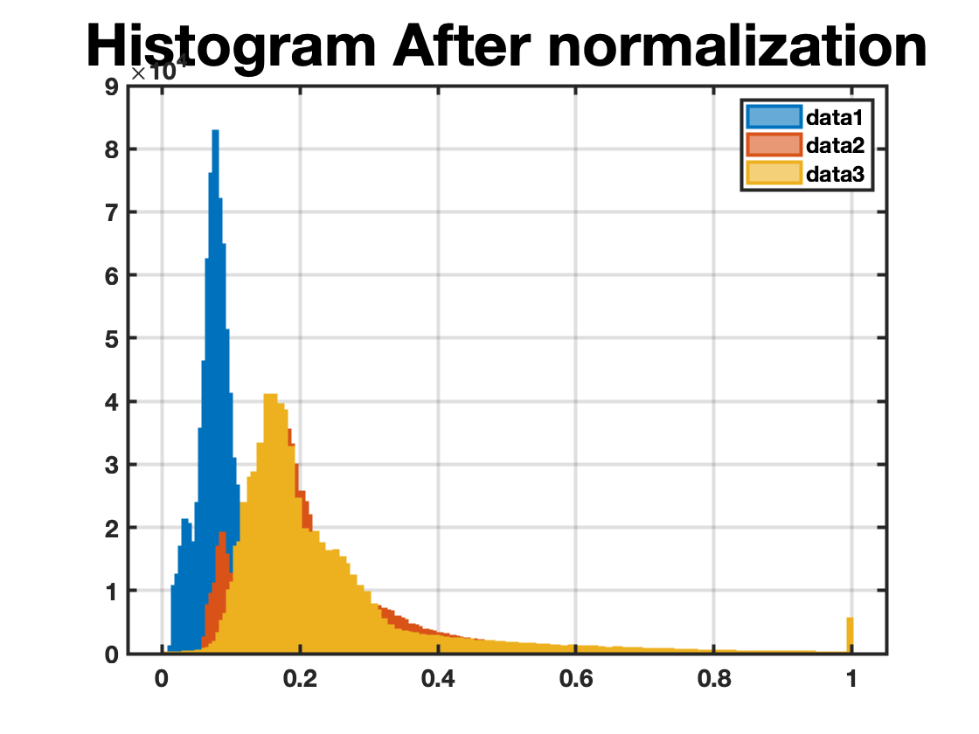
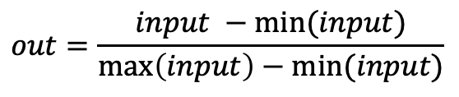
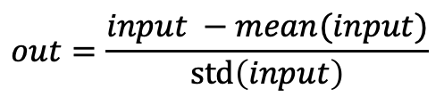
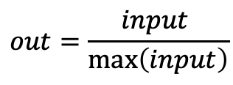
Normalize data
Click me
The normalization is commonly used to adjust the range of data.
The library supports, up to now, three types of normalization:
Min-Max
$$out=\frac{input −min⁡(input)}{\max\left(input\right)−min⁡(input)}$$
Max
$$out=\frac{input }{\max\left(input\right)}$$
Standardization
$$out=\frac{input −mean(input)}{\operatorname{std}\left(input\right)}$$

Slide 7
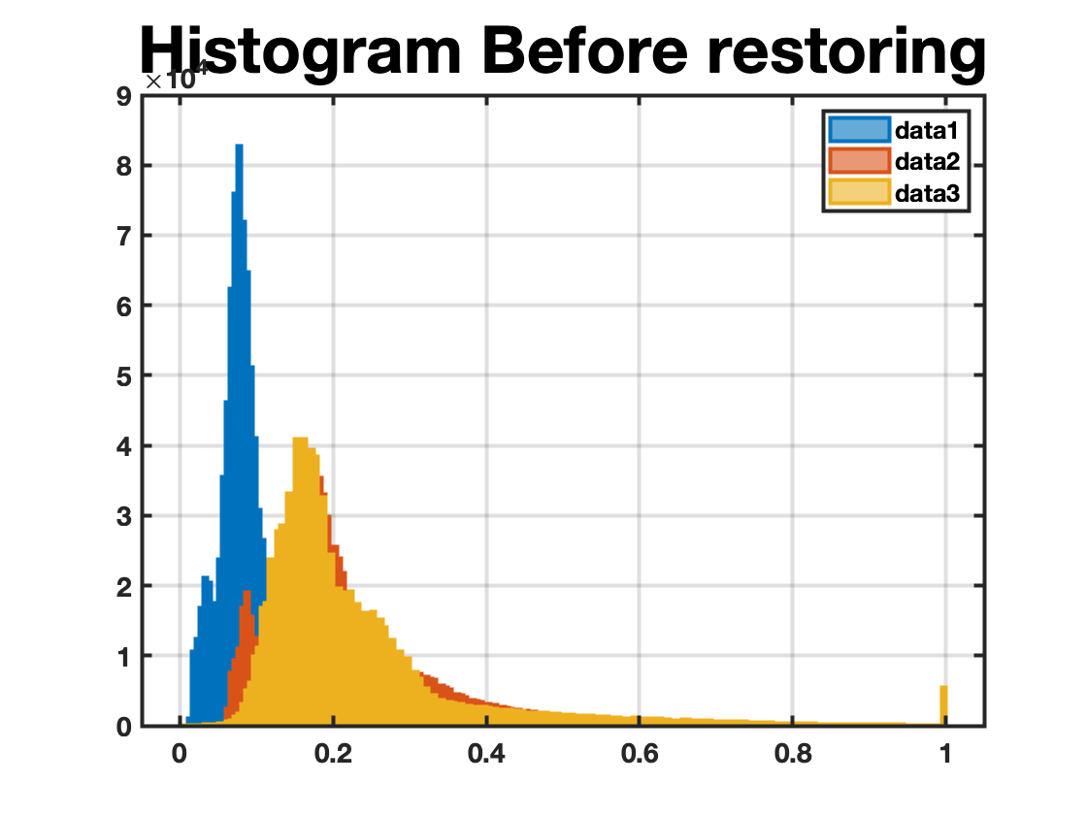
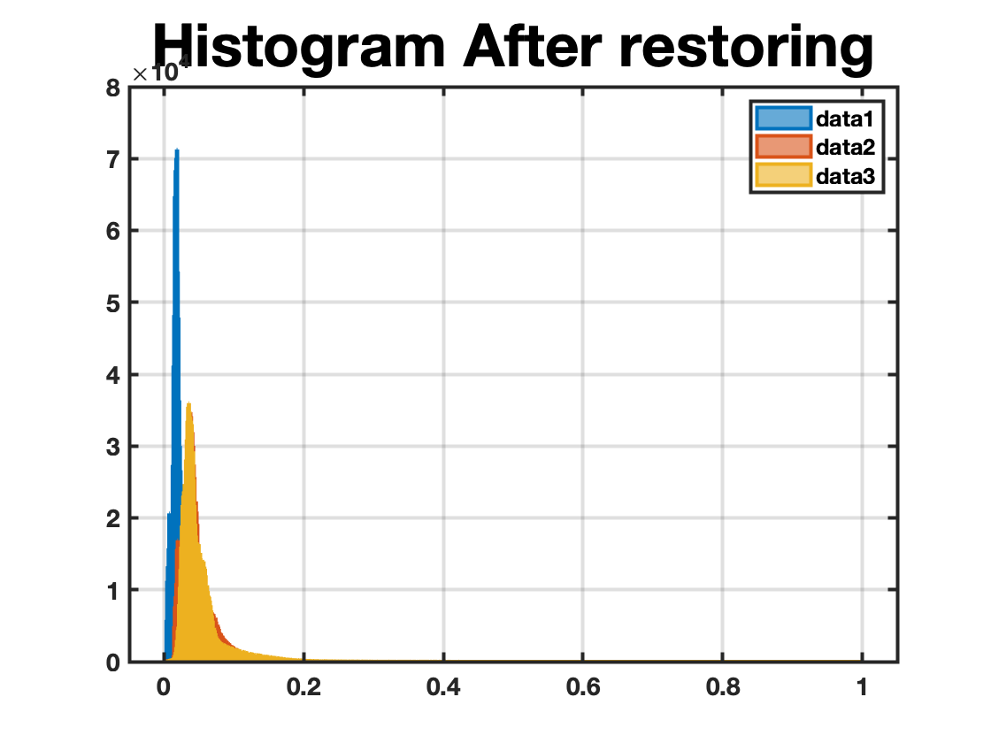
Restore range
Click me
This function is used to restore the range of values, after applying the normalization.
This function can be used when we need to apply some processing to the image (in the range 0-1, e.g. filters, index calculation) and after that we want to save the new image with the original range.
This function strongly depend on the normalize data function.

Slide 8
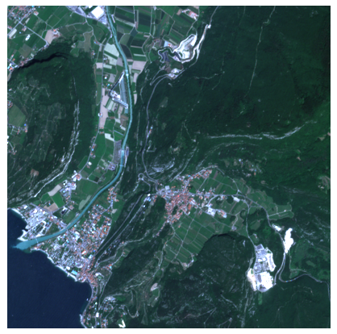
Crop
Click me
This function ca ben used to
extrapolate a small patch from the input data

Slide 9
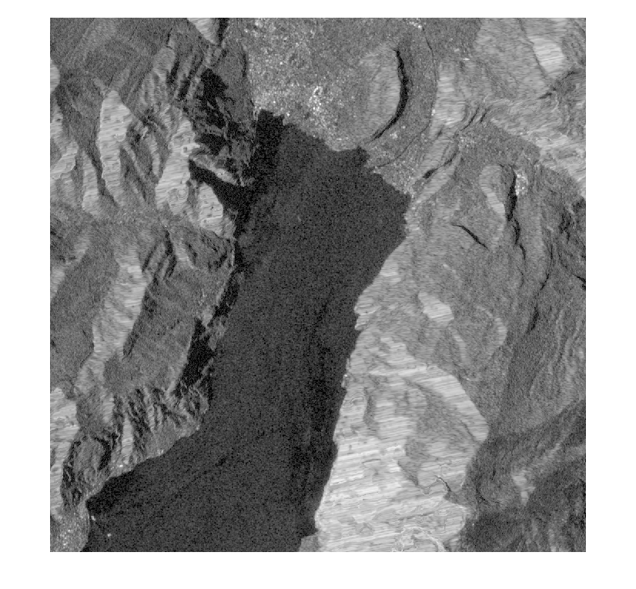


Apply Filter
Click me
This function ca be used to filter noise from the input image. The function supports different types of filter: wiener, median, minimum, maximum, etc.
Input
Wiener
Median

Slide 10
Utilities

Slide 11
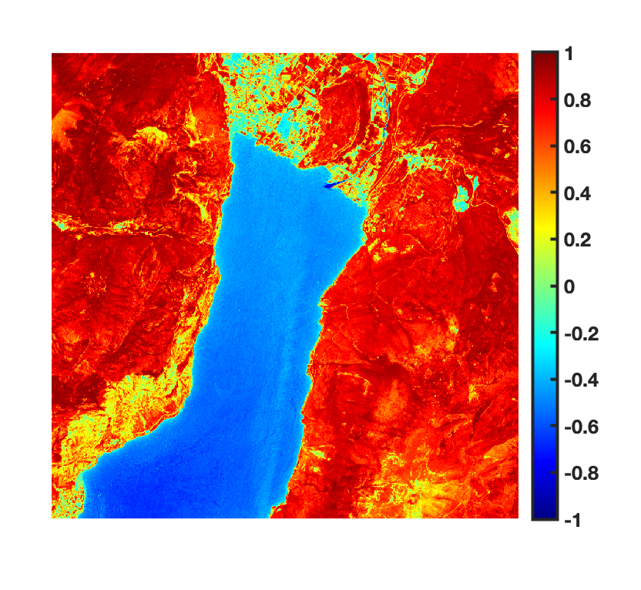
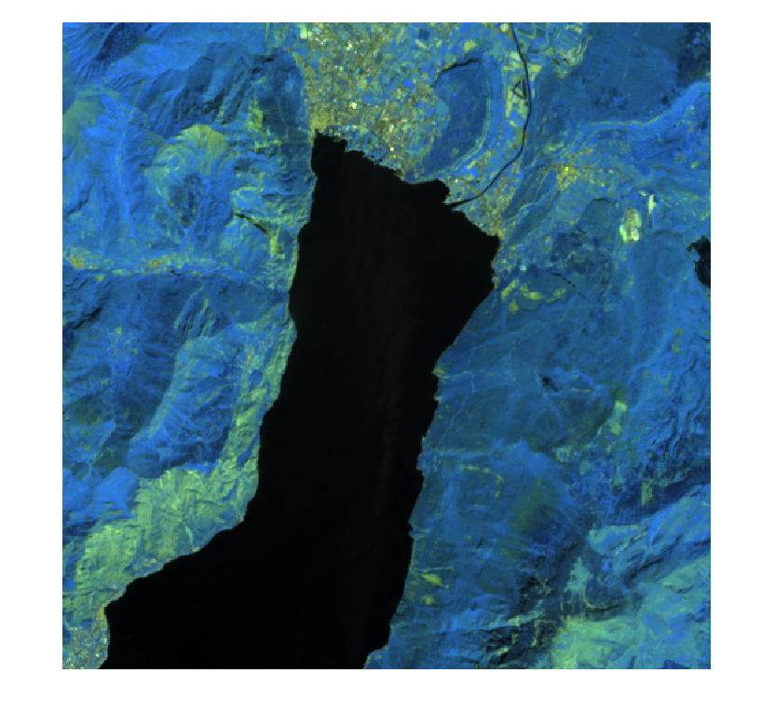
Plotter
This function can be used to plot some useful graph in an easiest way.
Click me
The plotter takes as input the data, a list of band, a string and two boolean values.
The bands are used to plot for example the RGB image. The string is used to complete the title.
The boolean values, are used to plot an histogram for each band or to plot an image for each band.

Slide 12
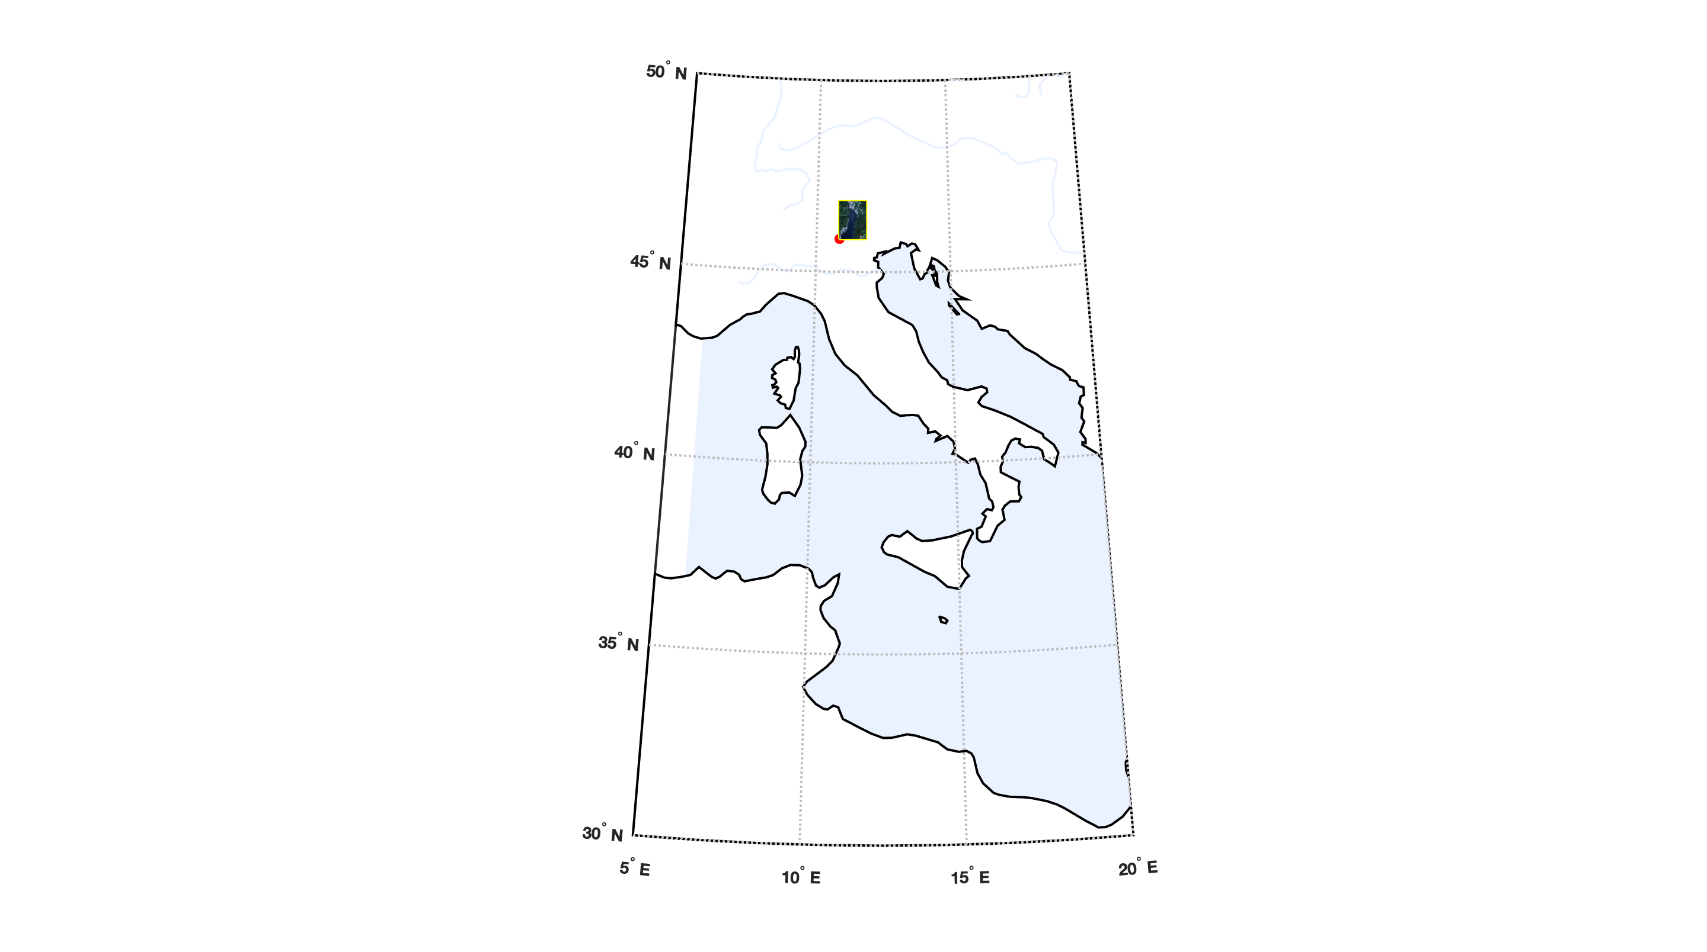
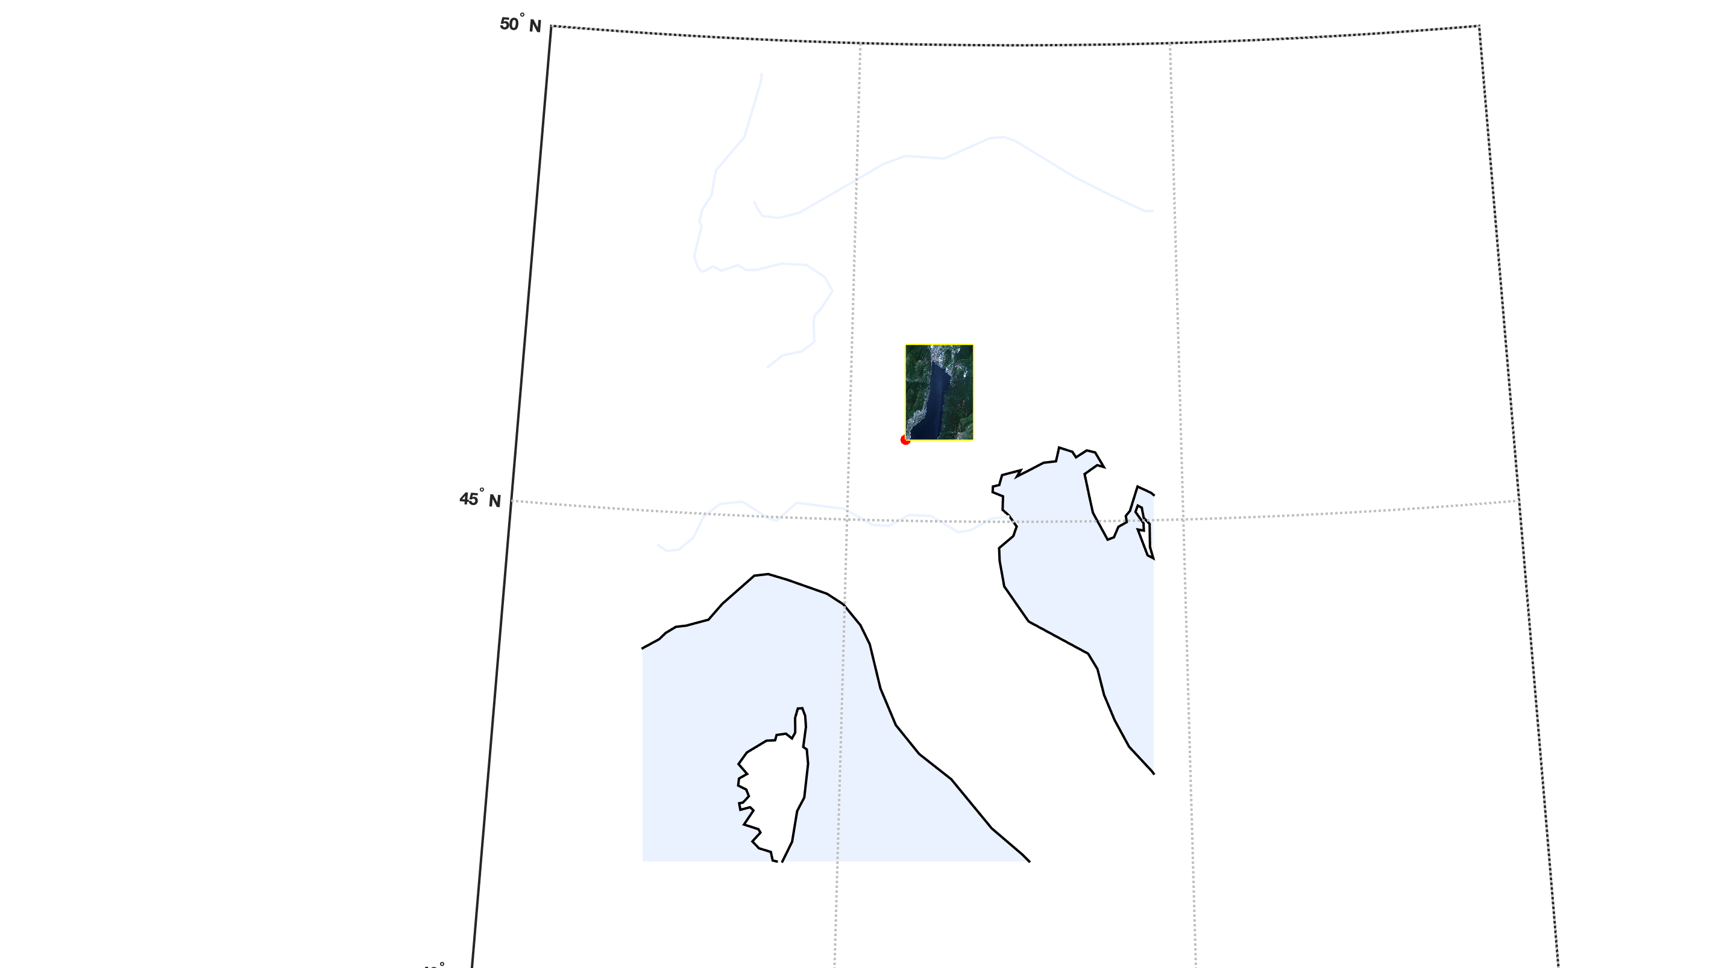
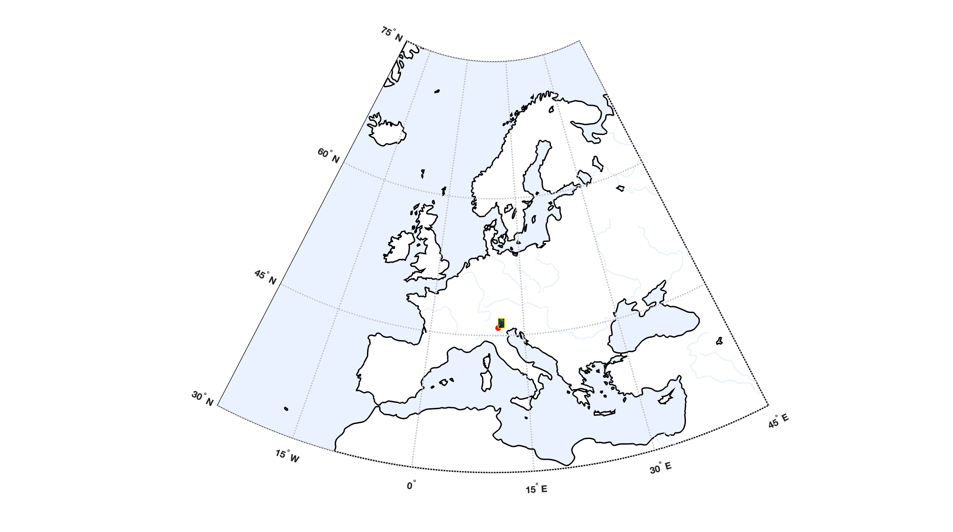
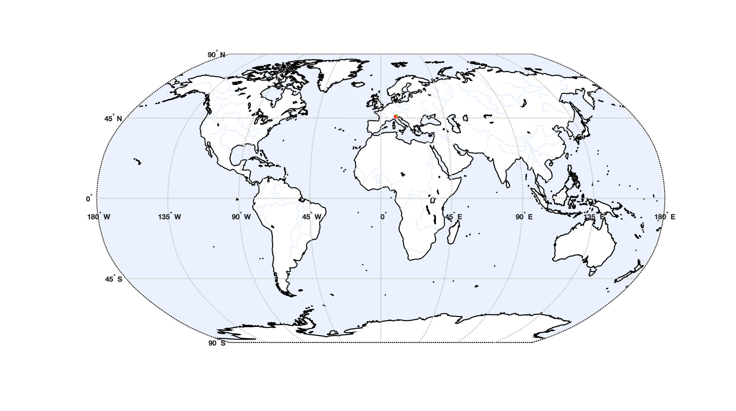
Geo Plot
Click me

Slide 13
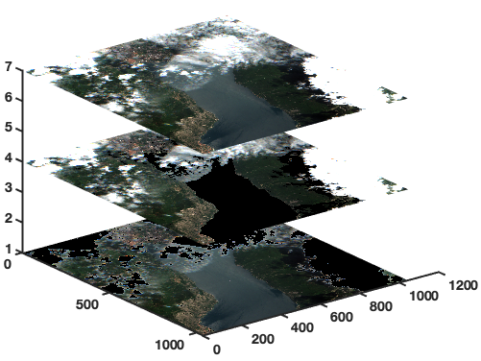
Cube plot
This function can be used to stack different images in a 3D cube.
Click me
RGB
The function takes as input the data to be plotted and a integer used to select a defined number of bands to be plotted together.
Water mask
Cloud mask

Slide 14
Post-processing functions

Slide 15
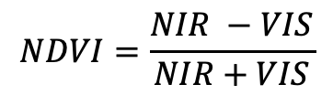
NDVI (1)
The normalized difference vegetation index (NDVI) is a simple graphical indicator that can be used to analyze the measurements obtained by remote sensing, typically but not guaranteed by a special satellite, and assesses whether the observed area contains live living.
The pigment of the leaves, chlorophyll, strongly absorbs visible light (from 0.4 to 0.7 μm) for use in photosynthesis.
The cellular structure of the leaves, on the other hand, strongly reflects light in the near infrared (0.7 to 1.1 μm).
$$NDVI=\frac{NIR −VIS}{NIR+VIS}$$

Slide 16
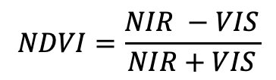
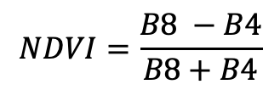
NDVI (2)
Let us assume that we are working with Sentinel-2 data
$$NDVI=\frac{NIR −VIS}{NIR+VIS}$$
$$NDVI=\frac{B8 −B4}{B8+B4}$$

Slide 17
NDVI (3) – calculate NDVI
Click me
The calculate NDVI function takes as inputs a multiband satellite image and a list of index that identify the NIR and VIS bands.
In this particular case the plot uses the jet color palette.

Slide 18
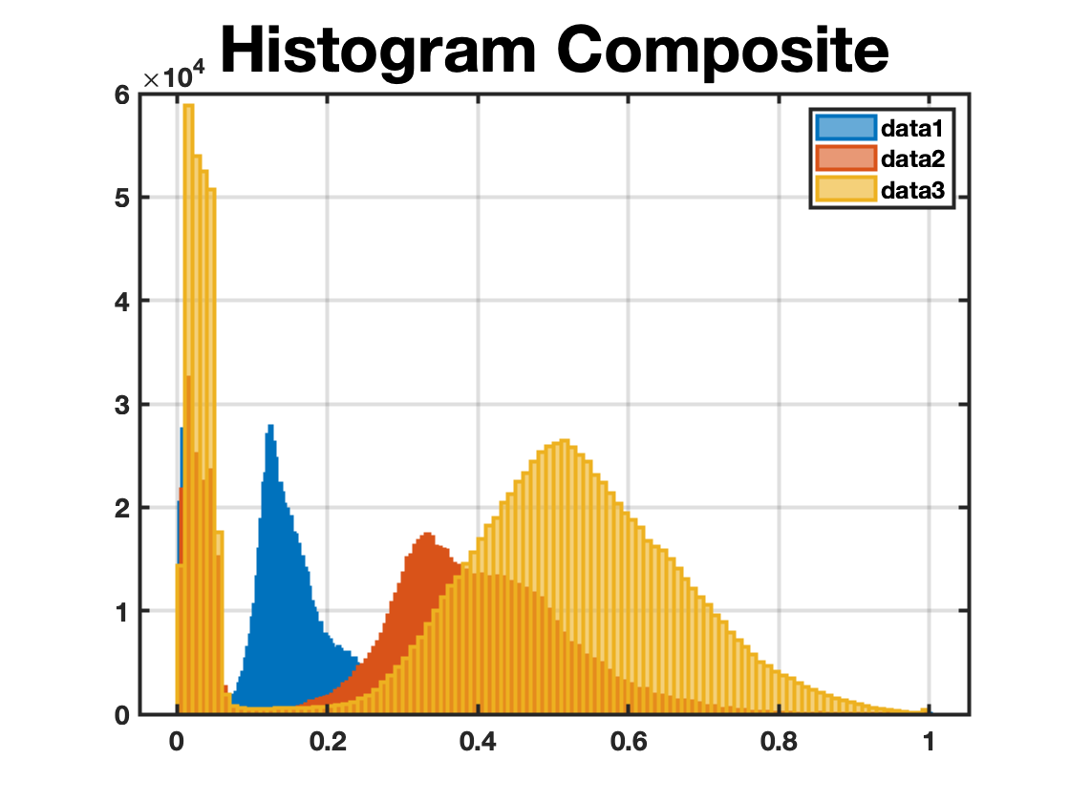
Create Composite
Click me
This function can be used to combine different bands and to obtain a new data.
In this case instead of using the classic RGB bands, the image is created by using the bands B13, B12 (SWIR) and B8 (NIR).
With this composite the water basins are highlighted.

Slide 19
Water mask
This function can be used to create a water mask. It is based on a threshold algorithm, so sometimes some attempts are needed to reach a good result.
Click me
The function takes as inputs, the input data, 3 IR bands and the threshold.
The function returns the masked image and the mask.

Slide 20
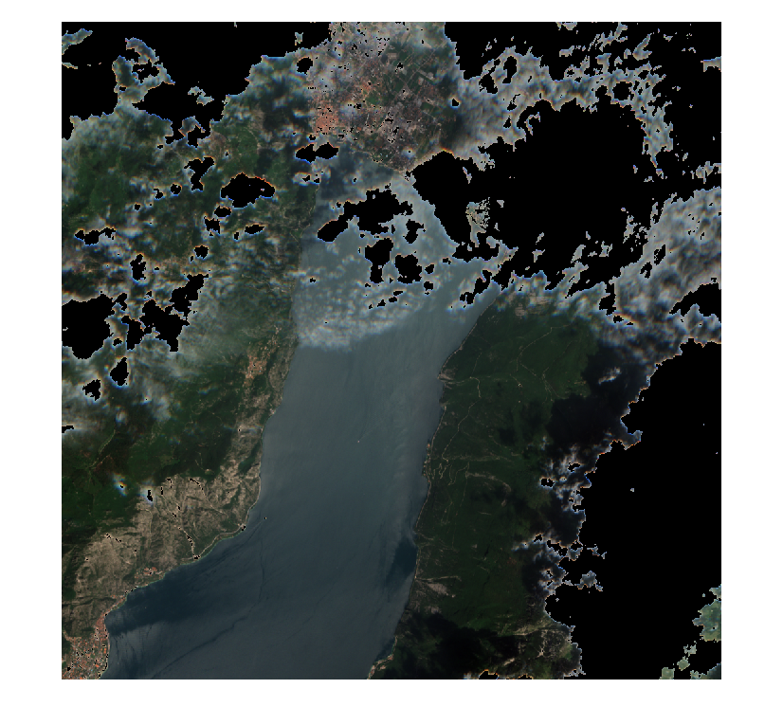
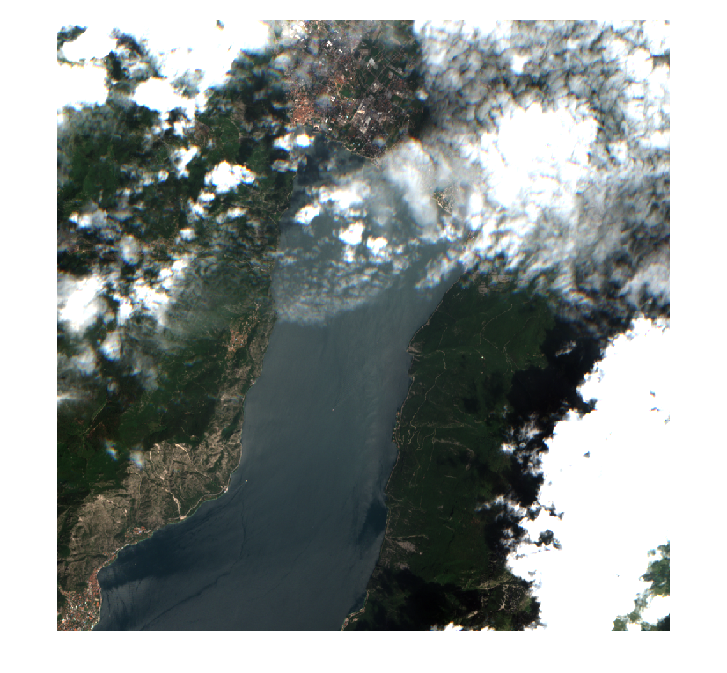
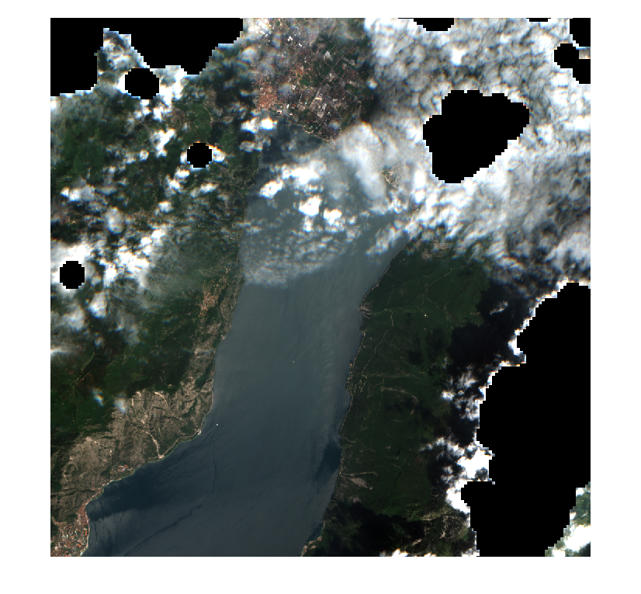
Cloud mask
Threshold method
This function can be used to filter the cloudy pixels. It can be used with a threshold or with a pre-exsisting cloud mask (Sentinel-2 data contains a raw cloud mask).
Click me
The function takes as inputs, the input data, the threshold or the number of the band which contains the cloud mask, and the mode (mask or threshold).
The function returns the masked image and the mask.
Cloud mask method

Slide 21
Tests

Slide 22
Tests
Test 1
Read
Normalize
Test 2
Crop
Geo plot
Test 3
Plotter
Test 4
NDVI
Test 5
Composite
Test 6
Water Mask
Test 7
Cloud Mask
Test 8
Cube plot
Test 9
Apply Filter
Test 9
Time-series

Slide 23
For the next update

Slide 24
To-Do
2D spectrum
Batch processing
Images co-registration
GUI?
Compatibility with new data
….

